Slide 1
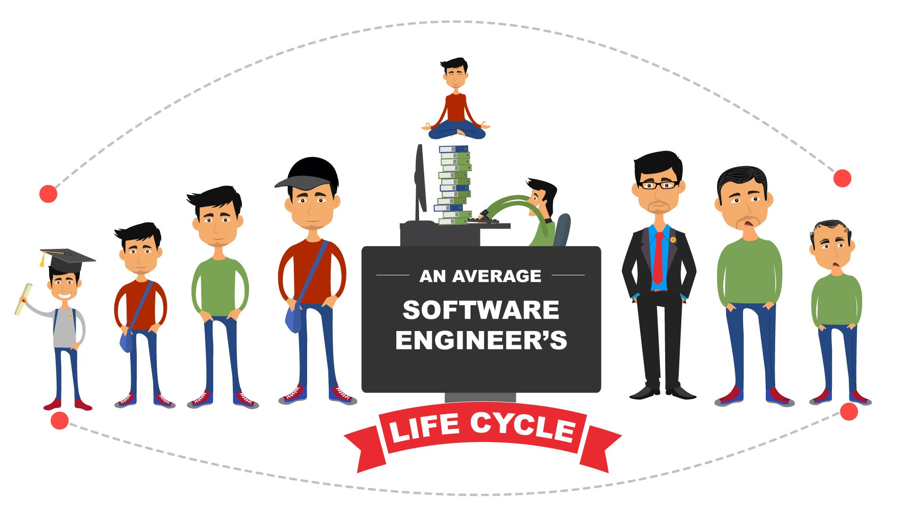
PART-I
Software Engineering (SE)
CSEN 3202 – CSE/BTech/6th Semester
Module-I → Prepared by : Nilina Bera, CSE, HITK

Slide 2
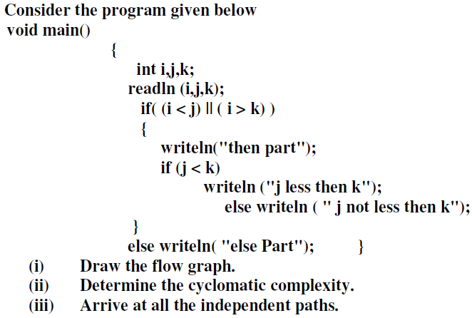
What is Software Engineering?
: a branch of computer science that deals with the design, implementation, and maintenance of complex computer programs
Before we proceed to Introduction, let’s have a look at a numerical problem.
This is just an intro… we will learn CFG in detail under Testing…..
Nilina Bera

Slide 3
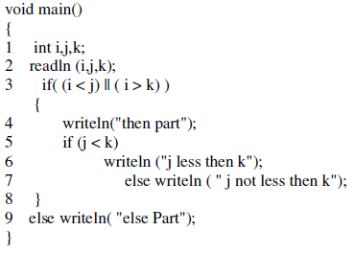
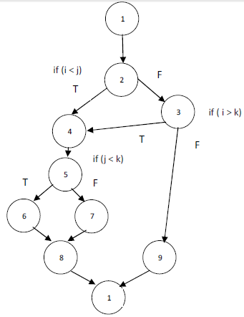
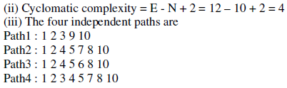
Problem is there, how to solve it?
First number the lines of Code.
Draw control flow graph.
Compute CC.
Independent Paths
10
There can be one more path..............................
Nilina Bera

Slide 4
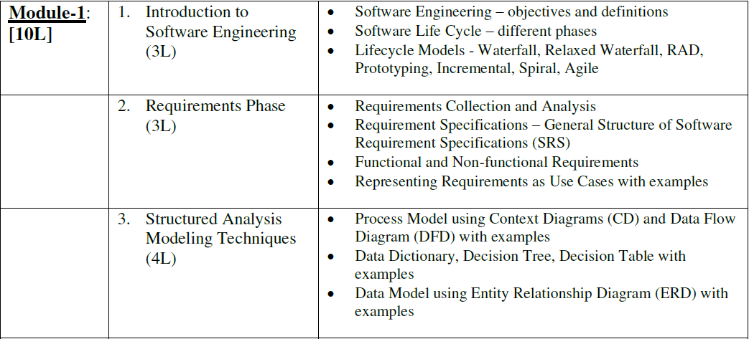
What we have to cover in this semester module wise ?
Nilina Bera

Slide 5
Before discussing various software engg. principles as noted in module-I, let’s try to gain some ideas on program vs. product.
Programs are developed by individuals for their personal use.
They are small in size and have limited functionality.
Further, the author of a program is usually the sole user of the program and him/herself maintains the program.
Example: the programs developed by a student as part of his/her class assignments are programs and NOT software products.
On the other hand, software products have multiple users and, therefore, have good user-interface, proper users’ manuals, and good documentation support.
Since a software product has a large number of users, it is systematically designed, carefully implemented and thoroughly tested.
Nilina Bera

Slide 6
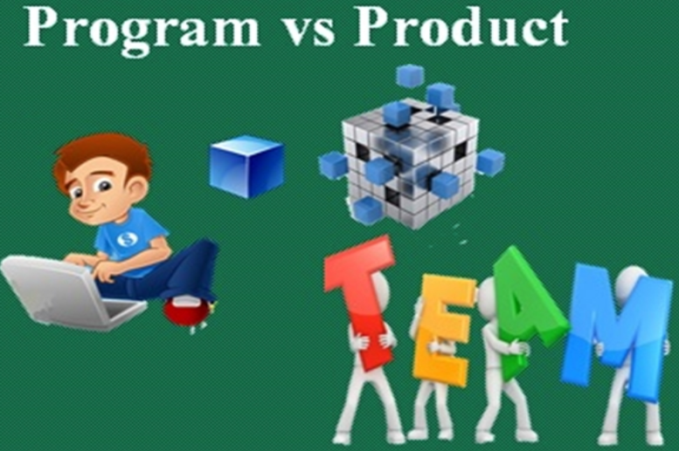
Software engineers who develop software products and programmers who write programs → Since a group of software engineers usually work together in a team to develop a software product, its necessary for them to adopt some systematic development methodology.
Otherwise, they would find it very difficult to interface and understand each other’s work and produce a coherent set of documents.
Example of Products we use daily????
Nilina Bera
Apps on smartphone, FB, Twitter, IDEs, python, MATLaB, R et. al.

Slide 7
Software Engineering (SE)
From where to start?
What is the subject?
How to apply the subject?
What we are supposed to learn from this subject?
SE is the application of a 1) systematic 2) disciplined 3) quantifiable approach to the development and maintenance of s/w and the study of these approaches, i.e., the application of engineering to software.
Nilina Bera

Slide 8
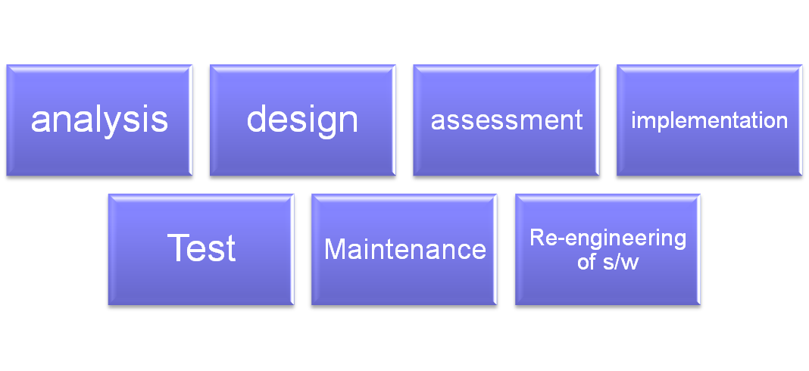
What is the application of engineering to software?
Application of SE integrates significant mathematics, computer science and practices whose origins are in engineering.
Application of engineering to s/w: Systematic approach to the ➔ Figure 1…
Nilina Bera

Slide 9
Thought-process of SE
The starting point of SE – the first appearance was in 1968 NATO SE Conference and was meant to provoke thought/perception of “s/w crisis” at that time and the journey began from there.
SE is here to stay to fine tune the process of Figure 1, according to Money Magazine, Salary.com, Forrester Research, Gartner etc.
Nilina Bera

Slide 10
Example: SE is largely concerned with programming with system products supported by effective analysis and design and a wide range of testing… Let’s try to understand SE in real life:
Read the following paragraph and identify the correct statement.
“Imagine that you were recently hired as a software engineer to a company that specializes in aircraft navigation control software. While orientating yourselves to the company’s work practices, you observe that they in fact do not conduct a few tests that they should in order to comply with the relevant safety standard. When you inquire about this from the project manager, he dismisses it saying that those tests are really unnecessary (and takes an unreasonably long time to conduct, as well as being superfluous) and that they have managed with the other tests for so long, without any problems.”
Nilina Bera

Slide 11
You should immediately resign from the company and file a complaint with the relevant standard institution
(b) You should do nothing and let the matter slide
(c) Although you are new to the company, and you hardly know anything about the internal processes and politics, you should insist on the company changing its work practices immediately; failing which you threaten to report the matter
(d) Since you are new to the company, and you are unfamiliar with the internal processes and politics, you should first find-out more about the issue and its background
(e) None of the above statements are correct.
 | Answer : (d) Reason: D is the appropriate choice.
Nilina Bera

Slide 12
Revisit: What is SE?
This subject is the collection of systematic and cost-effective techniques to s/w development.
Engineering approach to develop software.
Systematic collection of past experience (techniques, methodologies, guidelines)
What exactly is an engineering approach to develop s/w?
Concept of Control-Flow based design. A program’s control flow structure indicates the sequence in which the program’s instructions are executed.
Nilina Bera

Slide 13
Example of an unstructured program if (customer_savings_balance > withdrawal_request) { 100: issue_money = TRUE; GOTO 110; } else if (privileged_customer == TRUE) GOTO 100; else GOTO 120; 110: activate_cash_dispenser (withdrawal_request); GOTO 130; 120: print(error); 130: end_transaction(); | b) Corresponding Structured program 1. if (privileged_customer || customer_savings_balance > withdrawal_request)) { 2. activate_cash_dispenser (withdrawal_request); } 3. else print(error); 4. end_transaction();
Nilina Bera

Slide 14
Control Flow Graphs of programs a) and b)
a) | b)
1
R3
1
R2
2
R2
4
2
R1
3
4
3
5
R1
In the build and fix (exploratory) style, normally, a poor quality program is quickly developed without making any specification, plan or design. The different imperfections that are subsequently noticed while using or testing are fixed.
7
6
8
9
10
Nilina Bera

Slide 15
From Control Flow graph, we can obtain McCabe’s cyclomatic complexity (CC) metric to derive test cases under software testing module [based on a) and b)]
Method1: Given a CFG(G) of a program (a) , the CC can be computed as :-
CC = E – N + 2 ➔ To determine number of faces or regions of a graph G = (V, E)
With E = 11, N = 10, CC = 11 – 10 + 2 = 3;
With E = 4, N = 4, CC = 4 – 4 + 2 = 2;
Method2: CC = Total number of non-overlapping bounded areas + 1
Note: Always true for planar graphs generated out of structured programs
CC = P + 1; P = Number of predicate nodes in the CFG. Predicate node is a node that contains a condition, which contains one or more edges emerging out of it.
CC = 2 + 1 = 3; b) CC = 1 + 1 = 2;
Method 3: Determining the no. of regions (bounded areas within the planar graph) + the area of the universal set.
a) CC = R1 + R2 + R3 = 3; b) CC = R1 + R2 = 2;
Nilina Bera

Slide 16
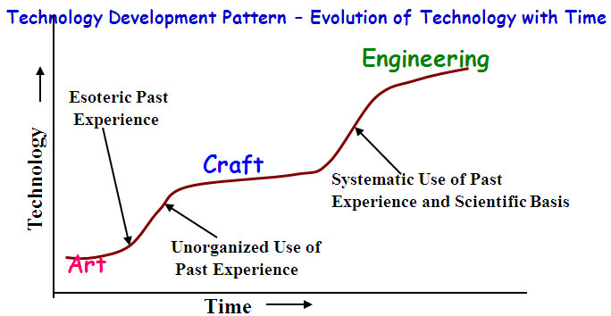
What is software engineering?
This subject is the collection of systematic and cost-effective techniques to software development.
Engineering approach to develop software.
Systematic collection of past experience, techniques, methodology, guidelines.
Nilina Bera

Slide 17
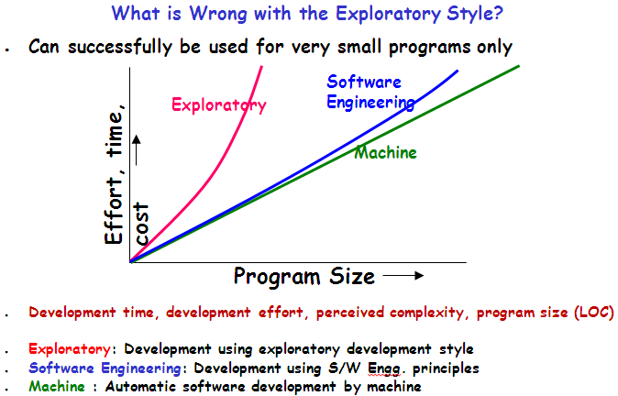
Nilina Bera

Slide 18
We talked about SE. What Is A Software?
Software is defined as a collection of programs, documentation and operating procedures.
The Institute of Electrical and Electronic Engineers (IEEE) defines software as a ‘collection of computer programs, procedures, rules and associated documentation and data’.
It possesses no mass, no volume, and no color, which makes it a non-degradable entity over a long period. Software does not wear out or get tired.
Nilina Bera

Slide 19
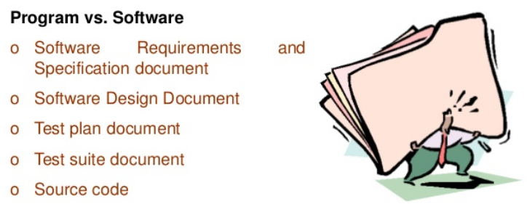
Nilina Bera

Slide 20
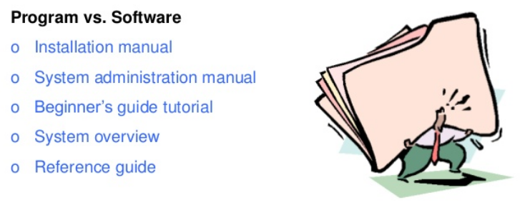
Nilina Bera

Slide 21
Classification of Software
Nowadays, almost each and every activity that we do somehow involves software applications in it.
Whether it is banking, paying bills, buying edibles, etc. However, all software's do not belong to the same category.
Software, on the basis of its applications, is broadly classified into the following categories:
System software
Application software
Engineering software
Embedded software
Web application
Artificial Intelligence (AI) software
Nilina Bera

Slide 22
System software: Refers to the facilitator that provides service to other software applications. The system software controls the timing of inputs, processing, and outputs. In other words, the system software interacts with the computer hardware; handles multiple users simultaneously; and regulates concurrent operations for resource reservation. Input/Output (I/O) scheduling, process management and memory management.
Nilina Bera

Slide 23
Application software: Refers to a set of programs that is developed to perform a specific function required by the user. The application software may also be developed for another application software. They are mainly classified as follows:
Office suites
Computer-mediated communication
Multimedia
Analytical software
Business software
Data based software (Oracle DBMS as an example)
There are many software Application Services Provider (ASP) companies and technology business consultancies specialized in the development of tailor-made software applications. The applications are normally spread across different verticals, financial domains, travel, energy, banking, trading, and retails. These applications help companies and end-users to save money, give better productivity, and provide high return on their investments (ROI).
Nilina Bera

Slide 24
Engineering software: Refers to the software developed for a specific application using the principles and formulas of engineering discipline. Some classical engineering softwares are:
System Simulation
Computer-Aided Design (CAD)
Computer-Aided Manufacturing (CAM)
Computer-Aided Engineering (CAE)
Nilina Bera

Slide 25
Embedded software: Refers to the software that accomplishes definite functions in controlled environment. Embedded software exists inside the hardware and provides a set of functions and features to the end user. Some of the examples of embedded software are:
Fuel control and dashboard display software in an automobile
Software in the keypad of appliances such as microwave oven and washing machine
Web application Software: Refers to the application that runs in a Web browser. Web applications not only offer separate features, computing tasks, and content to the client, but are also integrated with corporate databases and business applications for offering services such as e-commerce, e-business, Electronic Fund Transfer (EFT) etc. (ICICI bank online portal).
Nilina Bera

Slide 26
Artificial Intelligence (AI) software: Refers to the software working on non-numerical algorithms that utilize the data and information produced in the system to solve the complex problems using specific analysis and interpretation. The domains of AI are as follows:
Voice Recognition Systems
Robotics
Neural Networks
Expert Systems
Nilina Bera

Slide 27
Software Characteristics
Different individuals judge software on different basis. Why? Because, they are involved with the software in different ways.
Example, users (end users of the organization that would be using the product) want the software to perform according to their requirements.
Similarly, developers involved in designing, coding and maintenance of the software evaluate the software by looking at its internal characteristics before delivering to the users.
So, question is, what do WE software engineers (as a team) want a software product to be like ???
Nilina Bera

Slide 28
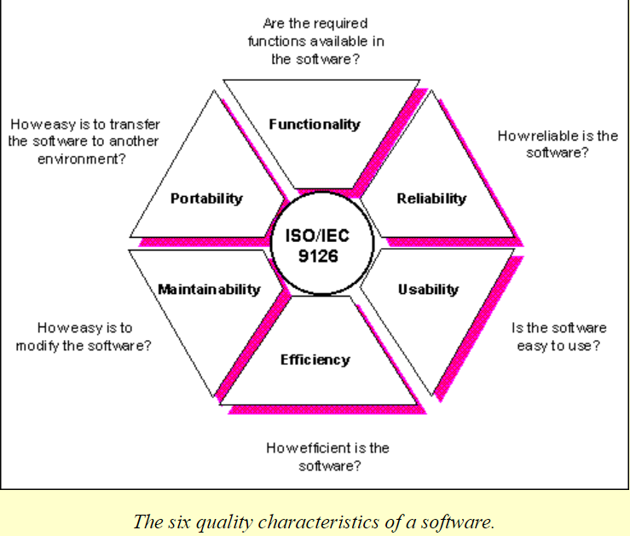
Nilina Bera

Slide 29
Functionality: Refers to the degree of performance of the software against its intended purpose.
Reliability: Refers to the ability of the software to provide desired functionality under the given conditions.
Usability: Refers to the extent to which the software can be used with ease.
Efficiency: Refers to the ability of the software to use system resources in the most effective and efficient manner.
Maintainability: Refers to the ease with which the modifications can be made in a software system to extend its functionality, improve its performance or correct errors.
Portability: Refers to the ease with which s/w developers can transfer software from one platform to another, without (or with minimum) changes.
Robustness & integrity: Robustness refers to the degree to which the s/w can keep on functioning in spite of being provided with invalid data while integrity refers to the degree to which unauthorized access to the s/w or data can be prevented.
Nilina Bera

Slide 30
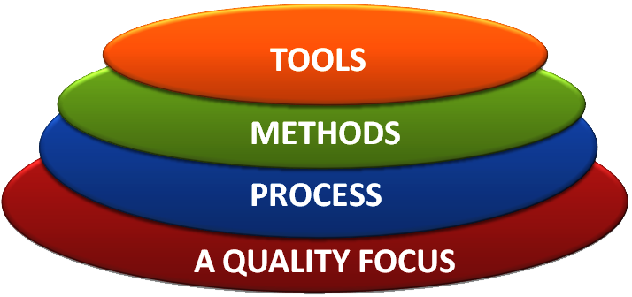
SOFTWARE ENGINEERING LAYERS
The process layer allows the development of software on time. It defines an outline for a set of key process areas (KPAs) that must be acclaimed for effective delivery of software engineering technology.
Nilina Bera

Slide 31
The method layer provides technical knowledge for developing software. This layer covers a broad array of tasks that include requirements analysis, design, coding, testing and maintenance phase of the software development.
The tools layer provides computerized or semi-computerized support for the process and the method layer. Sometimes tools are integrated in such a way that other tools can use information created by one tool. This multi-usage is commonly referred to as Computer-Aided Software Engineering (CASE). CASE combines s/w, h/w and SE database to create SE analogous to Computer-Aided Design (CAD).
Nilina Bera

Slide 32
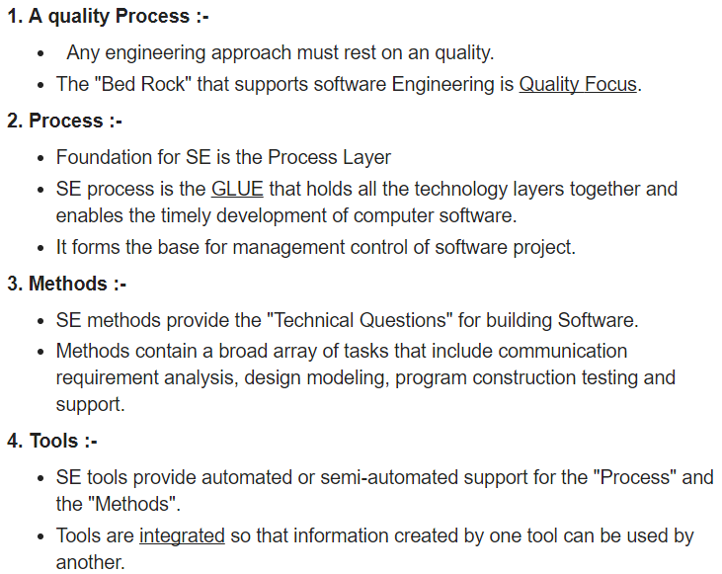
Nilina Bera

Slide 33
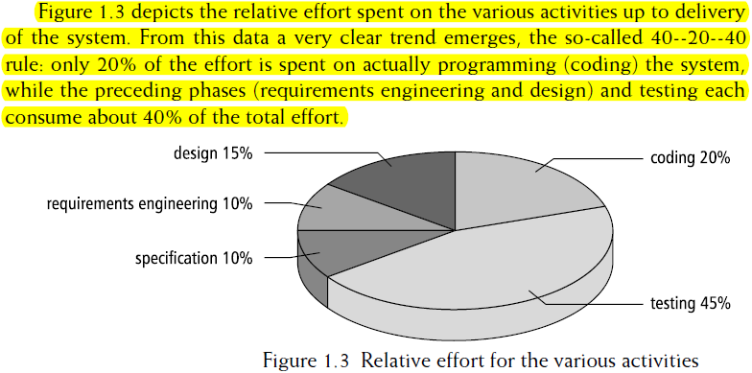
Nilina Bera

Slide 34
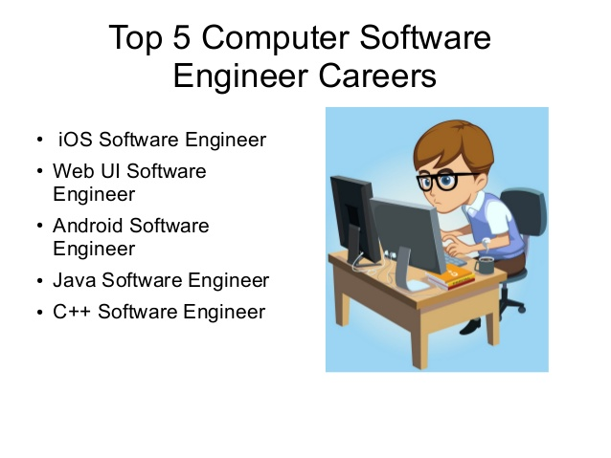
iOS (formerly iPhone OS) is a mobile operating system created and developed by Apple Inc. exclusively for its hardware. It is the operating system that presently powers many of the company's mobile devices, including the iPhone, iPad, and iPod Touch.
Nilina Bera

Slide 35
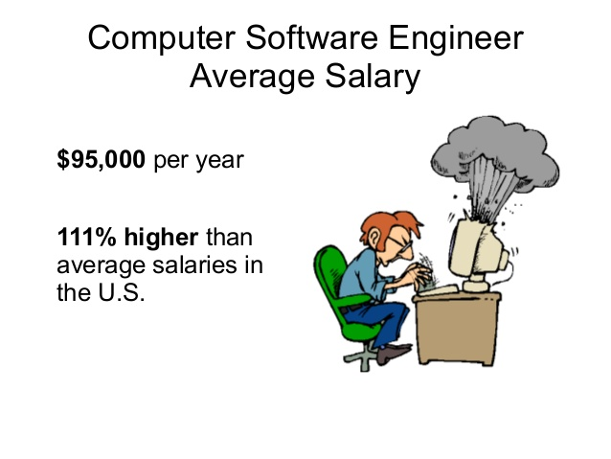
Nilina Bera

Slide 36
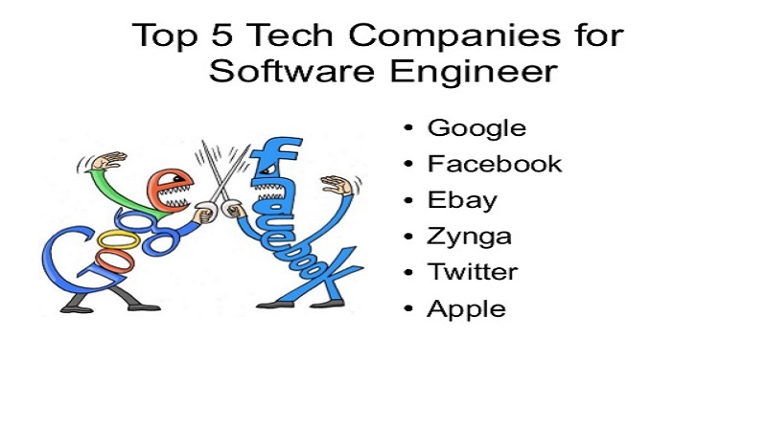
Nilina Bera

Slide 37
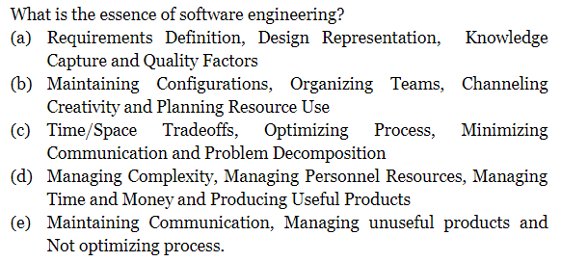

What is Software Engineering? Let’s drill further… a simple MCQ
Answer : (d)
Nilina Bera

